Slide 1
Oscilloscope and DMM Basics Introduction to Instrumentation

Slide 2
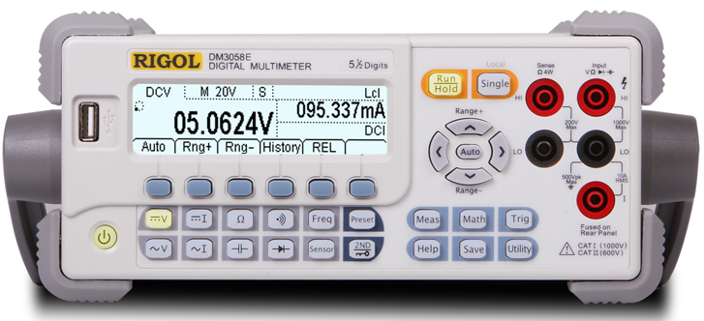
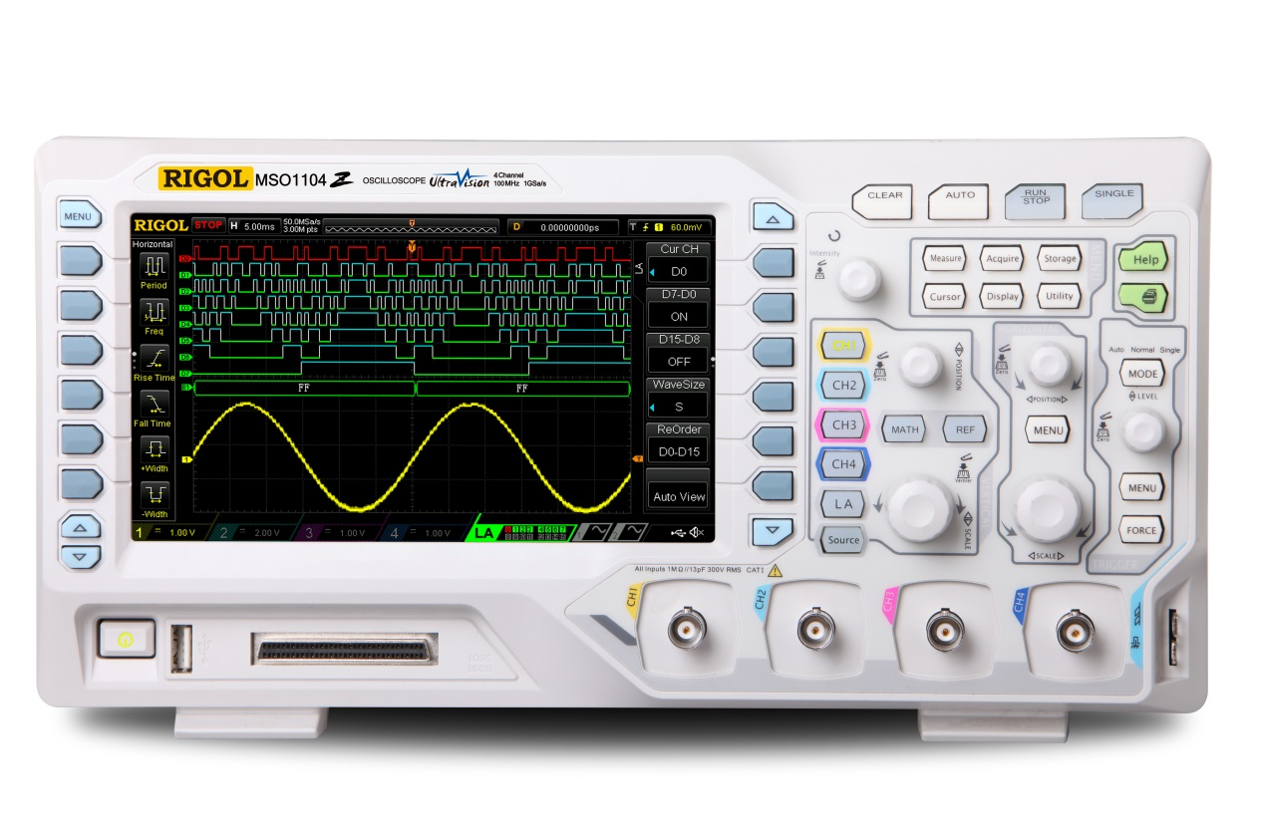
Signal and Instrument Basics
Ohm’s Law & DC Measurements
How a multimeter works
Peak to Peak vs RMS measurements
Sine waves and AC measurements
Digital Oscilloscopes Basics
How Deep Memory & Sample Rate work together
Triggering
Digital vs Analog Channels
Scope: potential sources of error
Sampling, Bandwidth & Rise Time
Waveform Capture Rate
Signal Acquisition Techniques
AC/DC Coupling
Probe loading & compensation
Square, Ramp, and Sawtooth waveforms
Understanding Signal Harmonics
Summary

Slide 3
Ohm’s Law
The first thing to learn to understand electrical measurements: V = I*R
Voltage = Current * Resistance (V is in volts, I in amps, R is Ohms)
Ω
Hands on tests:
- setup power supply
- measure and confirm voltage
- measure current
- identify resistor
- calculate Power: P = V²/R
1 VDC
A
0 V

Slide 4
Digital Multimeters
DMMs measure voltage with a high impedance connection
This means it draws very little current that might effect the circuit
This allows DMMs to measure up to 100s of MegaΩs
DMMs measure current with a low impedance connection
This means there is very little voltage across the DMM
This allows the DMM to measure current without disrupting the circuit
DMMs measure resistance by sourcing a small current and
measuring the resulting voltage
DMMs measure temperature by measuring the voltage of a
thermal junction of known materials
The type of a thermocouple gives a known
voltage to temperature relationship
Ω
1 VAC
V
A
0 V

Slide 5
Digital Multimeters – important settings
The most important tradeoffs in a DMM measurement are about speed and accuracy
Use the left and right keys to set the measurement speed
Faster measurements are less accurate
Set the NPLCs directly
Number of Power Line Cycles
The DMM integrates voltage over a number of 60 Hz cycles to improve measurements
Set the ranging
Auto ranging is usually correct
Up and down arrows allow manual ranging for more complicated signals or trouble shooting
Use REL (Relative measurements) to ignore a preexisting value in future measurements

Slide 6
RMS measurements vs Peak to Peak
Ohm’s law calculations are great for DC measurements. How do we use it to measure power when the voltage is AC or sinusoidal?
RMS Voltage is the Root Mean Square Voltage
It is defined as the DC voltage level with the same power as the AC value
Therefore, Pavg = Vrms²/R
Vpeak = Vrms*√2
Ω
1 VAC
Hands on tests:
- 2Vpp; 1 kHz signal
- use Measurements to verify (Vpeak/√2)
- compare with Vrms measurement
- compare with signal using Vrms as the amplitude
- measure both signals using ACV on the DMM
A
0 V

Slide 7
Sample rate, memory depth, and time
Example: To record a 1000 second signal with a scope that has a maximum 2 Million points of memory, the highest sample rate you can use is 2000 Samples per second.
Sample rate is related to memory depth to the length of the waveform in time
Typically, we extend the memory to continue using the highest possible sampling rate for as long as possible.
For instance, a 1 GSa/second scope can capture up to 12 milliseconds of data with 12 Million points of memory.
Alternatively, to capture a 1000 second wave at 2000 samples/second requires 2 million points of memory.
Memory Depth in points
Demonstration: high speed pulse measurements
Number of seconds of continuous sampling
Example: Sampling at 1 GSa/sec with a setting of 12 Million points of memory creates a waveform that is 12 milliseconds long.
Sample Rate - from 1 kSa/sec to 5 GSa/sec

Slide 8
Digital Oscilloscope – important settings
Vertical settings
Adjust the vertical settings in the channel controls
Setup probes here as well
Horizontal settings
Adjust horizontal settings with the time controls
Push the timebase adjustment to zoom in
Use the horizontal menu to find roll or XY mode
Acquire settings
The Acquire menu controls the memory depth and acquisition types
Display settings
Display settings control persistence and display modes
Measure settings add and analyze measurements
Math settings create additional analytical traces

Slide 9
Digital Oscilloscope – Triggering
An Oscilloscope captures voltage over time
What is shown in the center of the display depends on the trigger event.
The scope can be triggered on signal edges, pulses, digital patterns, and more.
The scope can analyze and display up to 50,000 triggered waveforms per second.
Hands on: set up a basic edge trigger on a sine wave. Move the trigger level up and down to see where the trigger point crosses the signal.

Slide 10
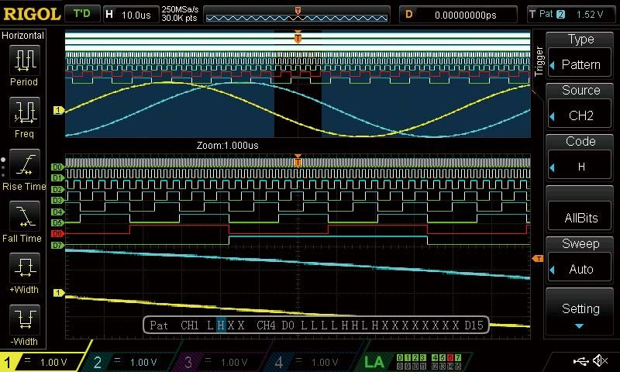
Digital Oscilloscope – Digital vs Analog Channels
An Oscilloscope captures voltage over time
What is shown in the center of the display depends on the trigger event.
The scope can be triggered on signal edges, pulses, digital patterns, and more.
The scope can analyze and display up to 50,000 triggered waveforms per second.
Hands on: set up a basic edge trigger on a sine wave. Move the trigger level up and down to see where the trigger point crosses the signal.

Slide 11
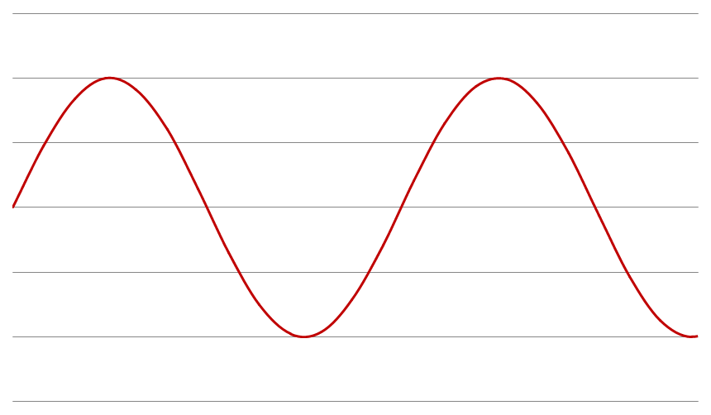
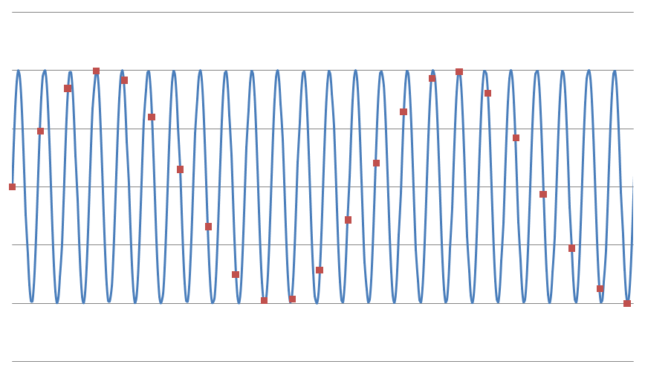
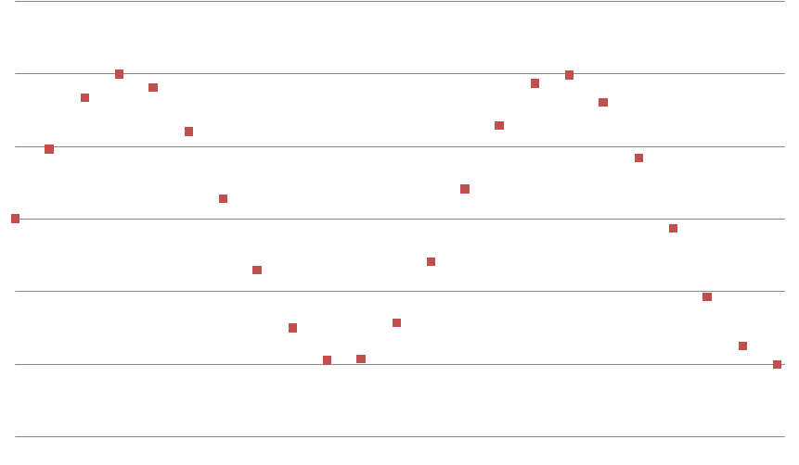
The risks of Under sampling
The Nyquist theorem states that you need to sample at 2* the max frequency you are looking for
Best practice is to have 5 times oversampling
Undersampling can lead to analytical errors
For example, look at the sine wave your scope is displaying. If you are under sampling this wave could be aliasing on a much faster signal
The results can’t be guaranteed with certainty unless the signal is sufficiently sampled
Hands on tests:
Change the scope display mode to dots to view the actual points
Adjust time base and memory depth to see how points are effected
See how high speed signal components can be missed

Slide 12
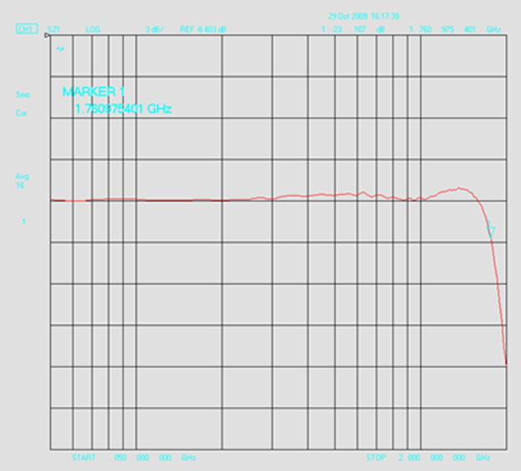
Bandwidth
The bandwidth of an oscilloscope is typically the -3 dB point which is
70.79% of the voltage
Bandwidth has 2 major impacts on signal measurements:
Amplitude attenuation
Rise Time
Use the 5X rule for Rise Time accuracy
This means to limit error have at least 5 X the bandwidth of the signal you are analyzing

Slide 13
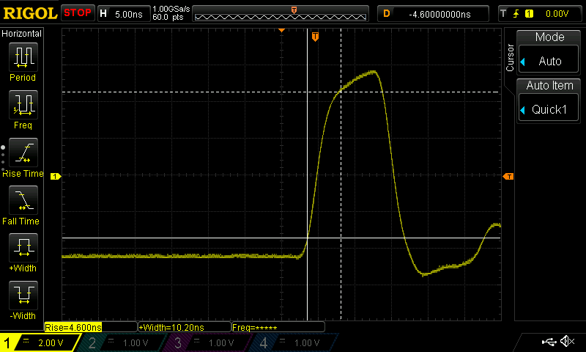
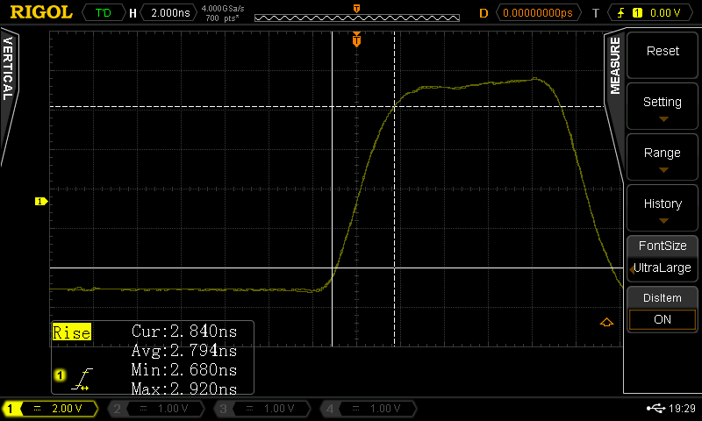
Rise Time
From the bandwidth you can infer the rise time:
RT = ~0.35/BW
How will that effect your signal?
RT of your measurement = √(RTscope² + RTsignal²)
A 50 MHz pulse is shown to the right on a 50 MHz and a 500 MHz scope
On the 50 MHz scope you can see the risetime measures considerably longer
From the math we can find that using a scope with 5 X the frequency of the signal components limits the error to ~ 2%
Demonstration: high speed pulse measurements. Use auto cursors to show the measurements.

Slide 14
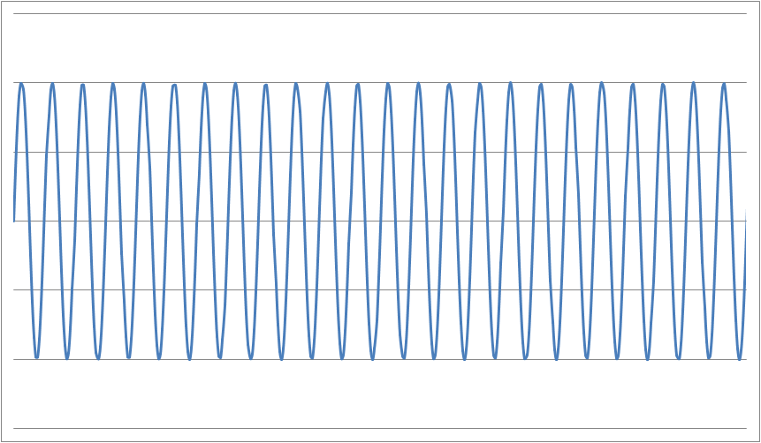
Waveform Capture Rate
Waveform Capture rate is the number of trigger events that can be captured and transferred to the display for viewing per second
Memory depth and sampling rate define the length of each sampling time
The scope uses dead time to analyze and move the data to the display
Any signal artifact during dead time do not appear on the scope
Be aware of dead time created by your settings when looking for occasional glitches
Demo: Glitch detection. Use persistence settings to view the signal. Use pulse triggering to find the artifact more easily
Dead
Time
Dead
Time
Dead
Time
Dead
Time
Sampling Time
Sampling Time
Sampling Time
Sampling Time

Slide 15
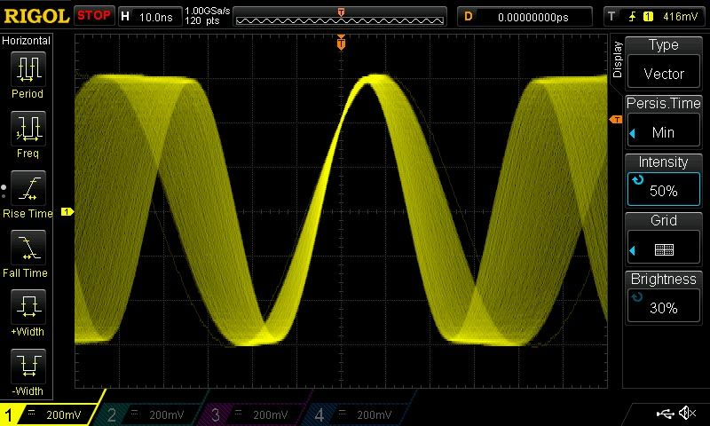
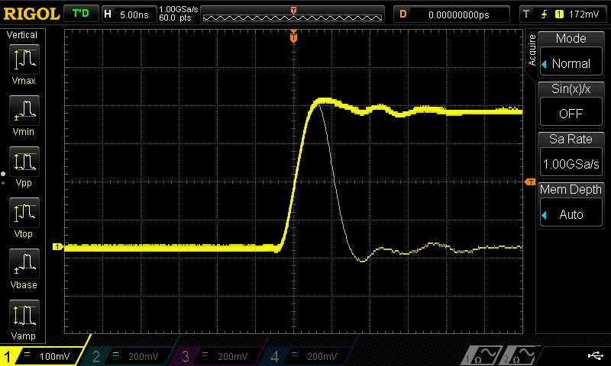
More than just a single specification…
Effective signal display is a
combination of:
Memory Depth
Sampling Rate
Bandwidth
Display Quality (intensity grading)
Waveform Capture Rate
Other advantages of digital scopes
Real Time Record & Playback Features
Image and data storage, recall, and manipulation
Notes:
Being able to see view and understand signals quickly and easily is key enjoying a digital scope. Years ago, digital scopes with limited hardware capabilities did significantly reduce the engineer’s ability to view signals in real time. Over the last few years, digital scopes have followed the same technology curve that moved us from desktop computers to iPhones and has enabled these digital scopes to detect, recreate, and analyze signals in real time better than traditional analog scopes. By sampling at 5-10 x the max bandwidth of the instrument a modern digital scope can detect any transition that the underlying analog front end can relay. But to be able to view it as well as an analog scope you need a high resolution display with significant color depth.
Many people talk about waveform acquisition rates as one of the most important specifications of an oscilloscope. For many types of testing that is true, but it isn’t the whole picture. Getting the most out of your scope is really a combination of sampling speed, acquisition rates, memory depth, the quality of the display, and the ways you can get additional information from the instrument.
There are really two distinct problems being addressed. First, helping the engineer find the problem as quickly as possible and second: helping the engineer determine causality for the issue and ultimately propose a solution.
Any scopes capability starts with its sample rate. Sampling speed is the number of data points it can capture per second. Advanced digital scopes for R & D work today should be capable of multiple GSa/sec. This value defines the likelihood of a short glitch or artifact being captured by the scope. The red sine waves with blue sample points shows an example. Even though the scope on the left is sampling 4 times the frequency of the signal which is more than enough to satisfy Nyquist and display the fundamental - this scope missed the artifact that is causing problems for your circuit. Much higher sampling rate is required to make sure you are catching any high frequency glitch.
When that glitch is random or occasional is when acquisition rates come into play – these are described in the number of waveforms per second. Suppose the glitch happens once per second and you are triggering on the rising edge of that sine wave (assume it is 50 MHz) looking for a problem. The scope auto sets down to 10 nSec per division so we only have 140 nSec on the screen. If your scope’s acquisiton rate is only 10,000 waveforms a second you have to sit on that signal for more than 8 minutes before you have a 50 % chance of seeing it. Then you need a display on your scope capable of showing that signal when it is captured for long enough and in such a way that you can process it and visualize what is happening.
In terms of memory depth, remember that the sampling rate of your scope is variable based on memory depth and the total time of your capture. For instance, if you have a 10 nSec glitch, your 500 MHz scope should be able to see it, but if you are on the 100 uSec/div range your sampling is limited by the 1.4 mSec width of the screen divided by the memory depth because the scope will turn down the sample rate so that it can fill the screen. If your scope has millions of points of memory depth it will be fine. The thing to remember here is that memory depth becomes even more important when measuring longer time views with your scope.
Without the combination of display quality, acquisition rate, signal processing horsepower, and memory depth technologies it is much more difficult to find the problem without knowing what it looks like before you start.
These technologies all work together to solve one of the headaches of R & D testing which is “I don’t know what I don’t know”. If you knew what the problem was and exactly how to capture it on a scope, it wouldn’t be a problem anymore. Using an advanced, modern oscilloscope limits “hunting time” – the time an engineer spends looking for the problem.
While acquisition speed, display quality, and deep memory helps you find a problem quickly, tools like these recording and playback features (along with dedicated front panel buttons and knobs) make it easier to debug and solve the problem once you have found it. In record mode, an engineer can use a mask on the recording to find failures within the recorded waveforms. Memory depth also plays a key role here as there is more data and waveforms available to search through to find correlations with other signals and establish a root cause.
Other complementary features for root cause analysis would include the ability to trigger on and decode various bus protocols as well as advanced on screen measurement capabilities. With an advanced modern scope you can directly input complex expressions that can then be displayed alongside the channel data.
All of these features work together to make a modern digital oscilloscope a great bench tool that can do more than a traditional analog scope. The video signal pictured is a good example. The depth of the signal is critical to understanding it. The signal can’t be understood without the color depth, display quality, and memory depth all working together.

Slide 16
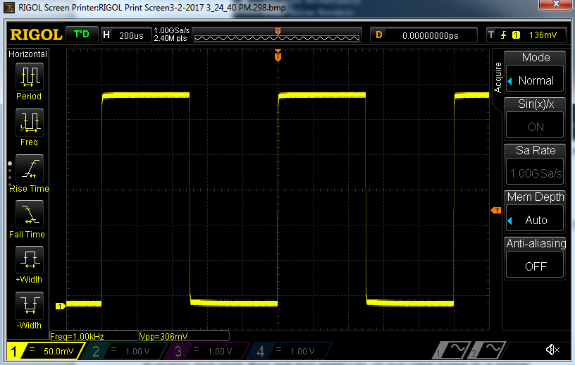
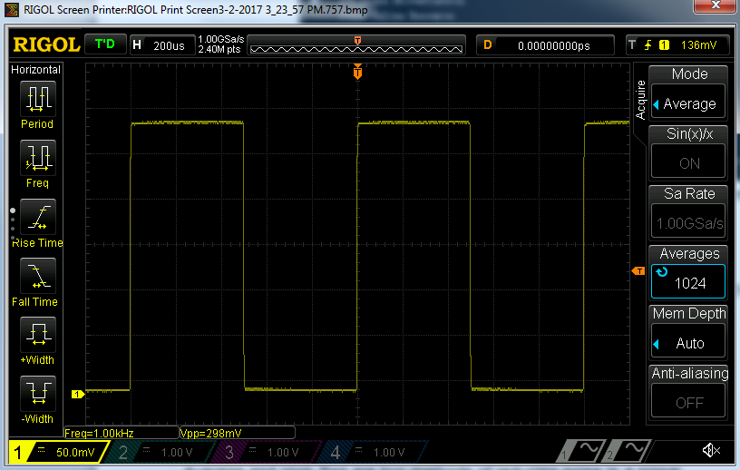
Acquisition Modes
Normal
Acquisition mode determines how the oscilloscope displays data from its memory
Normal mode displays evenly spaced data points
Peak emphasizes outlying data points
Average shows each point averaged over the last n captures
High Resolution averages within a single capture to lower noise without compromising fidelity
Be aware of your acquisition mode; Averaging will hide occasional glitches; High resolution will hide noise; Normal can miss high frequency spikes
Hands on:
Create a noisy or modulated signals and view how the acquisition modes display the data
High Resolution

Slide 17
AC vs DC Oscilloscope Channel Coupling
DC Coupling is the most common, default measurement method. Ideal for viewing the true amplitude of a signal
AC Coupling removes the DC portions of the signal making it easier to analyze waveforms that may have a large DC offset
To avoid errors make certain to use DC coupling when true amplitude or offset measurements are required
Hands on: create a signal with offset. Measure the signal with DC and AC coupling. Zoom in on the top of the signal.
Notes:
2 Vpp signal on –S with 1.5 Voffset can be zoomed to 200mv/div in DC couple. AC couple zoom to 2 mv/div

Slide 18
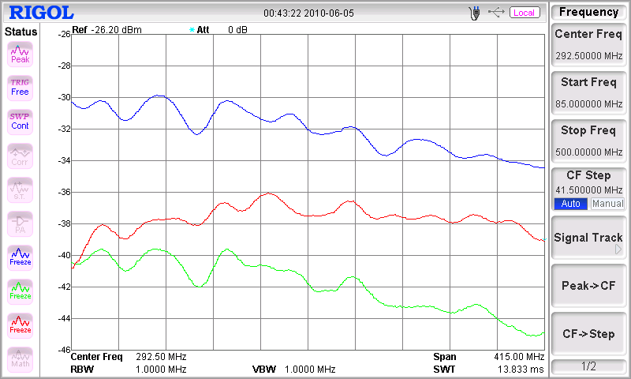
Probe Basics
Passive Probes are not flat over bandwidth. Be aware that they attenuate different frequencies differently
Passive Probes also have lower bandwidth in 1X mode. Older probe may only work to a few MHz. Newer wideband 1X probes can be good to 35 MHz or more
Use differential probes for non-ground referenced signals
Some probes have 1X/10X selector switches. Make certain the scope and probe settings match to get correct amplitude readings

Slide 19
Probe Loading
Probe loading is when connecting the oscilloscope’s probe to the device actually changes the signals in the device by loading down the circuit causing voltage levels to fall
This is usually caused when the input impedance of the scope is insufficient and the scope itself becomes a relevant path to ground for current within the circuit
With 99MΩ and 1MΩ in series, 50 mV should be present across the 1MΩ resistor
99 MΩ
0.05 V
5 VDC
1 MΩ
0 V
Notes:
Shows difference with DMM. DUT is about 0.9 Mohm, so current

Slide 20
Probe Loading
1MΩ in parallel with 1MΩ = 500kΩ
With 99MΩ and 500kΩ in series, 99.5% of the voltage presents across the 99MΩ resistor leaving only 0.025V across the scope input
Avoid probe loading issues by understanding your source impedance. Use a DMM or high impedance probe to make these specialized measurements
99 MΩ
0.025 V
Scope &
Probe
5 VDC
1 MΩ
1 MΩ
0 V
Demo: Probe loading on circuit results in measurement error

Slide 21
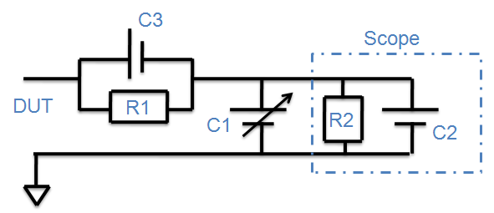
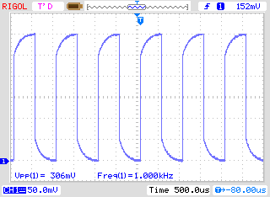
Probe Compensation
Properly compensated probes ensure the highest signal fidelity.
Use the probe compensation capacitor (C1) to balance your circuit.
R1*C3 = R2*(C1+C2)
Hands on: Connect the compensation test point and adjust the probe

Slide 22
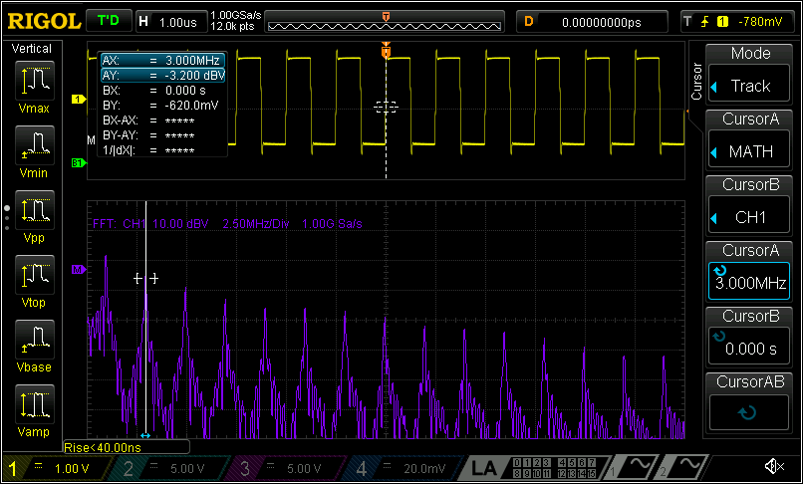
Signal Harmonics – Square, ramp, and sawtooth waves
Digital Oscilloscopes have the ability to measure in the frequency domain using an FFT (Fast Fourier Transform)
Complex waveforms have many harmonic components
Square and ramp waves have only odd harmonics
Sawtooth and asymmetric ramps or square waves include even harmonics
Hands-on: look at the FFT of each signal type

Slide 23
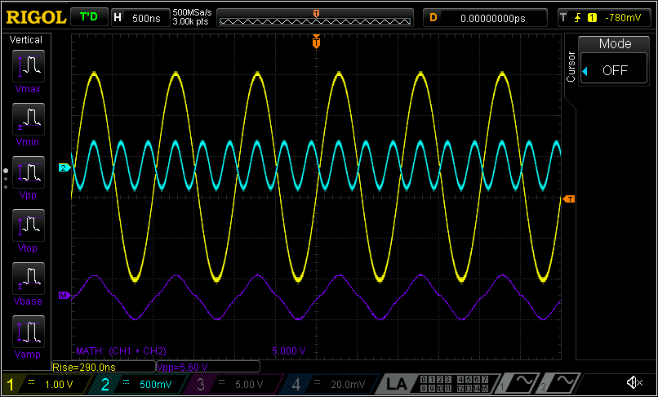
Signal Harmonics – Square, ramp, and sawtooth waves
Understand how these waves are created by emulating them
Square wave
3rd harmonic is 1/3 * signal amplitude
Triangle wave
3rd harmonic is 1/3^{2 *} signal amplitude and 180 degrees out of phase
Sawtooth wave
2nd harmonic is ½ of the signal amplitude
(cross zero negative together)
Hands on:
Use math to show sum of the first two harmonics

Slide 24
DMM Basics Summary
Understanding how a DMM makes measurements makes it easier to verify connections and debug issues
Always be aware of the settings, connections, sensors, and device under test characteristics
Adjust speed, ranging, and accuracy to optimize the measurements
Select the correct measurement function for your signal type
Use advanced features like measurement history and relative measurements

Slide 25
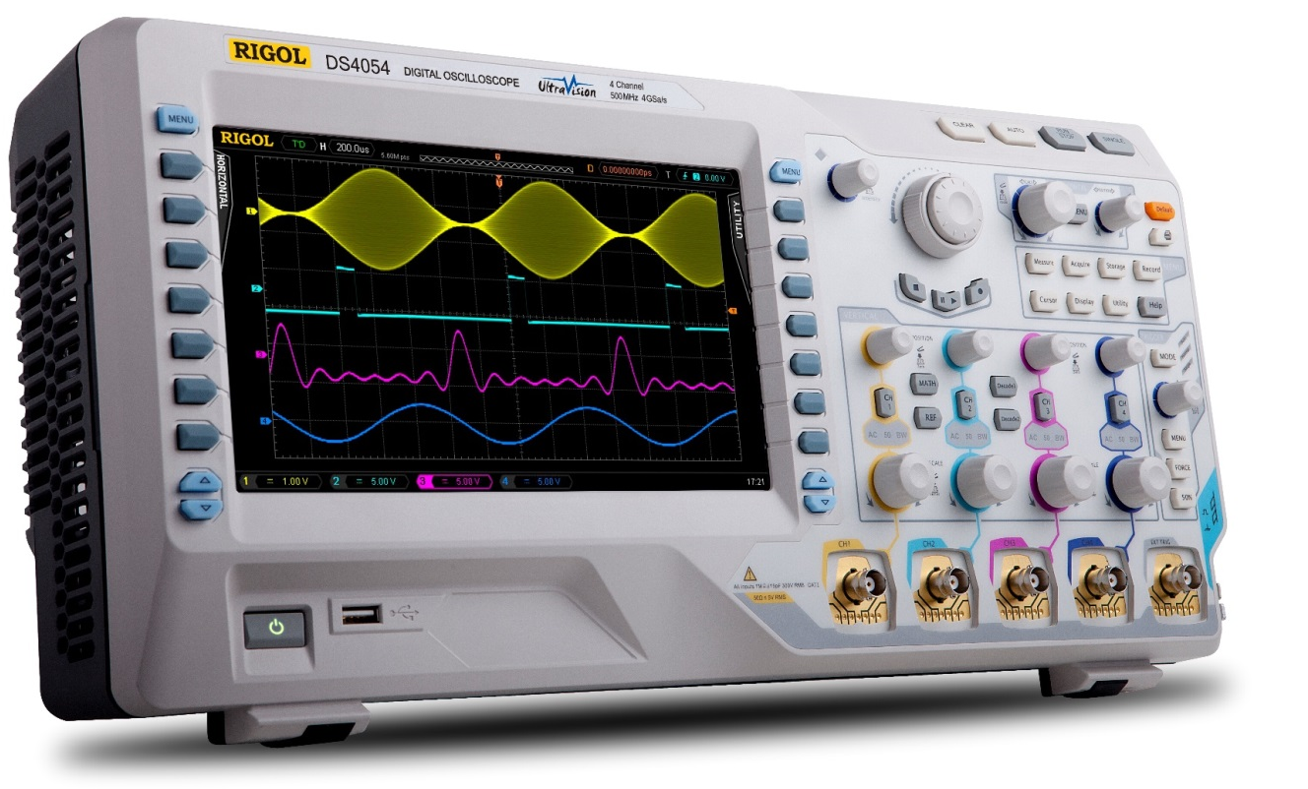
Oscilloscope Basics Summary
Understanding these common issues, settings, and signals and the theory behind them can help to avoid bad measurements
Always be aware of the settings, connections, probes, and device under test characteristics
Use advanced trigger modes to detect important signal characteristics quickly
Use digital channels to simplify digital data on a computer bus or interconnect
Use advanced features including FFT, math, and measurements to understand the nature of signals and errors

Slide 26
Additional Resources
Oscilloscope Basics website
https://www.rigolna.com/basicsofscopes
Videos on topics covered today and many more including
Introduction to Scopes
Triggering
Signal Integrity
Advanced Analysis
IoT web application videos and application notes
https://www.rigolna.com/iot
Power Analysis
Serial Communication
Sensor Characterization
RF Signal Analysis

