Slide 1
Signal Integrity Basics How to locate sources of error and improve signal integrity in your measurements RIGOL Scope Basics

Slide 2
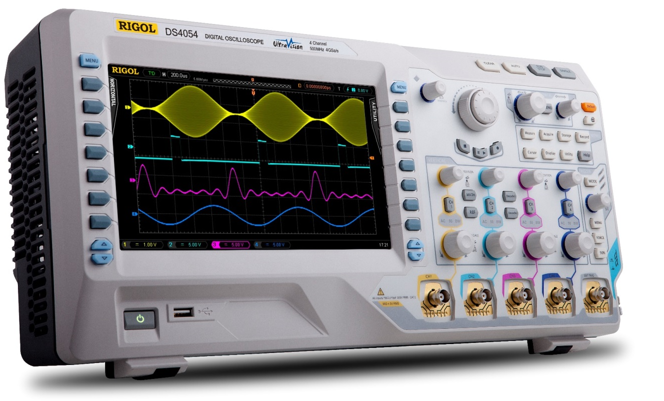
Signal Integrity Basics
Understanding and eliminating sources of error
Digital Oscilloscopes
How Deep Memory & Sample Rate work together
Scope: potential sources of error
Sampling Techniques
Bandwidth & Rise Time
Waveform Capture Rate
Amplifier distortion
Signal Acquisition Techniques
AC/DC Coupling
Probe: sources of error
Probe basics
Loading
Compensation
Impedance

Slide 3
Sample rate, memory depth, and time
Example: To record a 1000 second signal with a scope that has a maximum 2 Million points of memory, the highest sample rate you can use is 2000 Samples per second.
Sample rate is related to memory depth to the length of the waveform in time
Typically, we extend the memory to continue using the highest possible sampling rate for as long as possible.
For instance, a 1 Gsa/second scope can capture up to 12 milliseconds of data with 12 Million points of memory.
Alternatively, to capture a 1000 second wave at 2000 samples/second requires 2 million points of memory.
Memory Depth in points
Number of seconds of continuous sampling
Example: Sampling at 1 GSa/sec with a setting of 12 Million points of memory creates a waveform that is 12 milliseconds long.
Sample Rate - from 1 kSa/sec to 5 GSa/sec

Slide 4
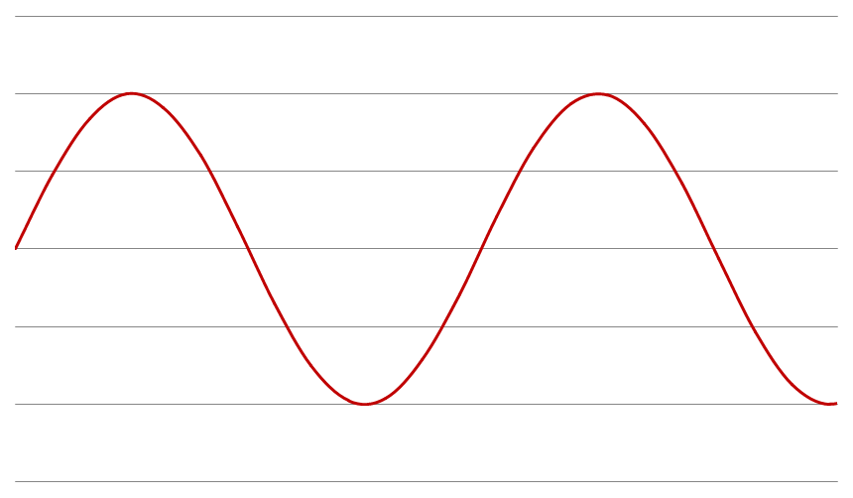
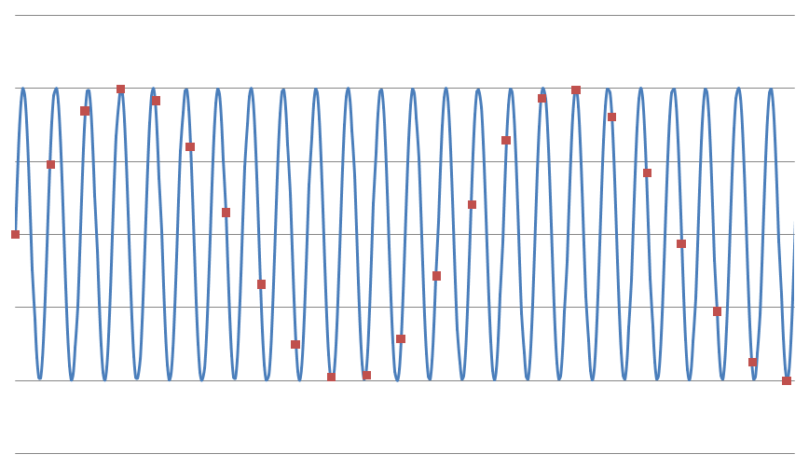
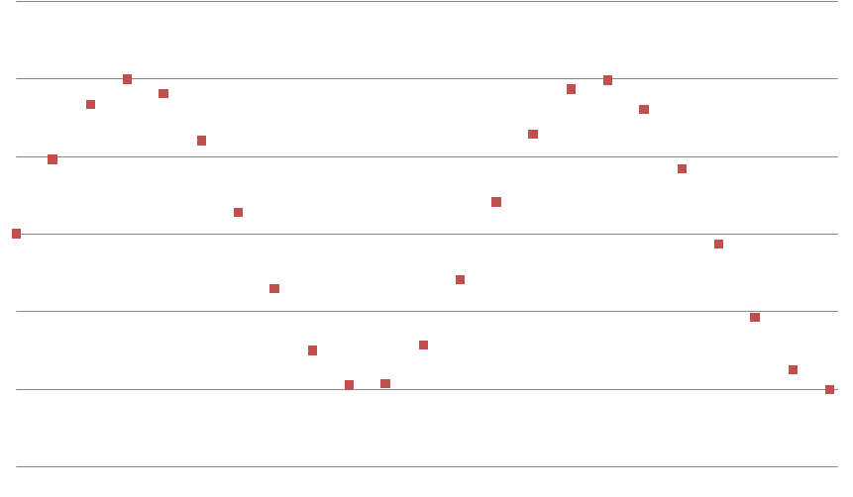
The risks of Under sampling
The Nyquist theorem states that you need to sample at 2* the max frequency you are looking for.
Undersampling can lead to analytical errors
For example, look at the sine wave your scope is displaying. If you are under sampling this wave could be aliasing on a much faster signal
The results can’t be guaranteed with certainty unless the signal is sufficiently sampled

Slide 5
Equivalent time sampling
This same effect is used to our advantage in Equivalent Time sampling
This is a mode that some digital oscilloscopes have for capturing higher speed signals
The signals is purposely undersampled, but with a prescribed time offset. In this way, if a signal repeats consistently, then its higher frequency can be reconstructed from offset data point in separate iterations of the period.

Slide 6
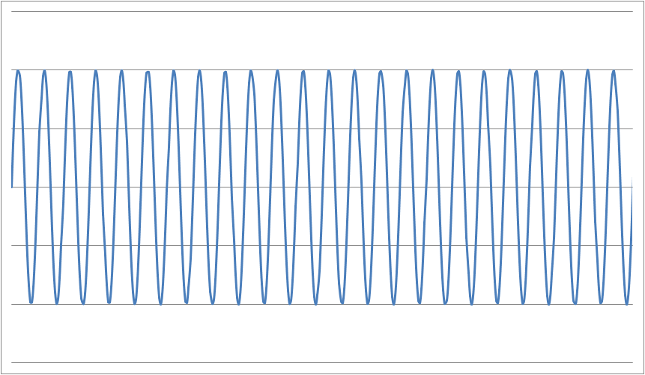
Equivalent time sampling
Using aliasing to recreate high speed signals
set sample interval to N * (1/[5 GSa/sec]) + (1/[50 GSa/sec])
N* 200 pSec + 20 pSec
Make N high enough so the scope can trigger and process data
Display the samples at 20 pSec intervals and update samples as you trigger instead of waves
under sampled with offset sampling recreated higher speed signal

Slide 7
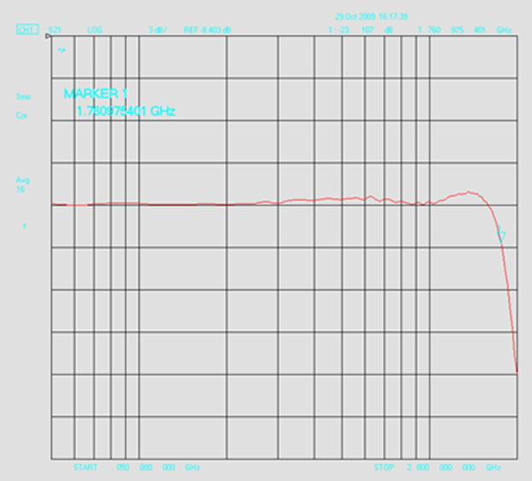
Bandwidth
The bandwidth of an oscilloscope is typically the -3 dB point which is
70.79% of the voltage
Bandwidth has 2 major impacts on signal measurements:
Amplitude attenuation
Rise Time
Use the 5X rule for Rise Time accuracy

Slide 8
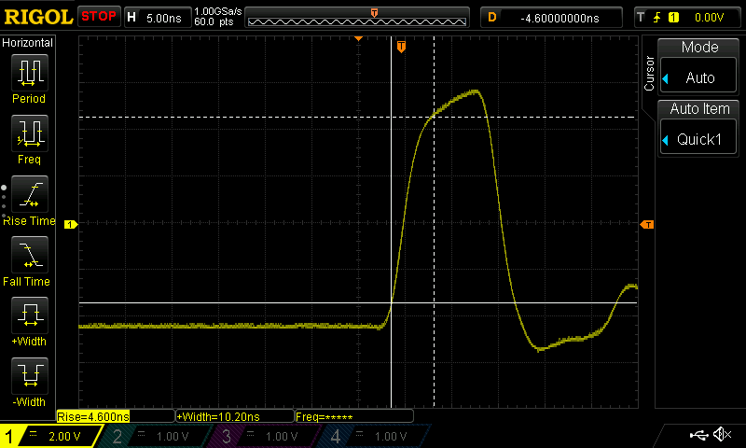
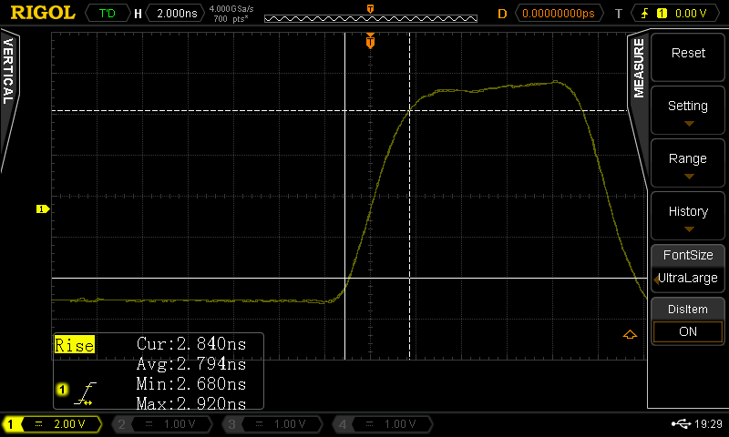
Rise Time
From the bandwidth you can infer the rise time:
RT = ~0.35/BW
How will that effect your signal?
RT of your measurement = √(RTscope² + RTsignal²)
A 50 MHz pulse is shown to the right on a 50 MHz and a 500 MHz scope
On the 50 MHz scope you can see the risetime measures considerably longer
From the math we can find that using a scope with 5 X the frequency of the signal components limits the error to ~ 2%

Slide 9
Waveform Capture Rate
Waveform Capture rate is the number of trigger events that can be captured and transferred to the display for viewing per second
Memory depth and sampling rate define the length of each sampling time
The scope uses dead time to analyze and move the data to the display
Any signal artifact during dead time do not appear on the scope
Be aware of dead time created by your settings when looking for occasional glitches
Dead
Time
Dead
Time
Dead
Time
Dead
Time
Sampling Time
Sampling Time
Sampling Time
Sampling Time

Slide 10
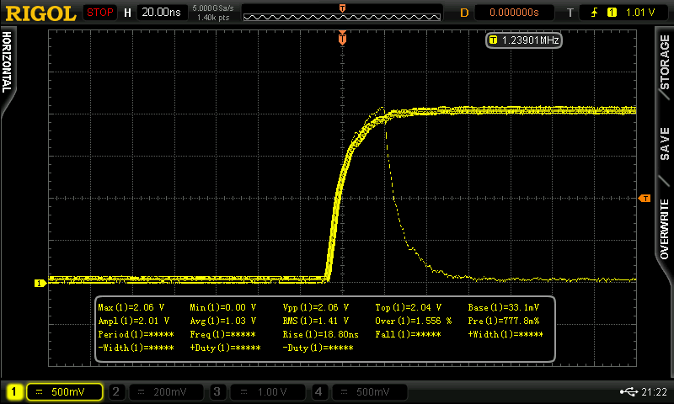
More than just a single specification…
Effective signal display is a
combination of:
Memory Depth
Sampling Rate
Bandwidth
Display Quality (intensity grading)
Waveform Capture Rate
Other advantages of digital scopes
Real Time Record & Playback Features
Image and data storage, recall, and manipulation
Custom Measurements
Notes:
Being able to see view and understand signals quickly and easily is key enjoying a digital scope. Years ago, digital scopes with limited hardware capabilities did significantly reduce the engineer’s ability to view signals in real time. Over the last few years, digital scopes have followed the same technology curve that moved us from desktop computers to iPhones and has enabled these digital scopes to detect, recreate, and analyze signals in real time better than traditional analog scopes. By sampling at 5-10 x the max bandwidth of the instrument a modern digital scope can detect any transition that the underlying analog front end can relay. But to be able to view it as well as an analog scope you need a high resolution display with significant color depth.
Many people talk about waveform acquisition rates as one of the most important specifications of an oscilloscope. For many types of testing that is true, but it isn’t the whole picture. Getting the most out of your scope is really a combination of sampling speed, acquisition rates, memory depth, the quality of the display, and the ways you can get additional information from the instrument.
There are really two distinct problems being addressed. First, helping the engineer find the problem as quickly as possible and second: helping the engineer determine causality for the issue and ultimately propose a solution.
Any scopes capability starts with its sample rate. Sampling speed is the number of data points it can capture per second. Advanced digital scopes for R & D work today should be capable of multiple GSa/sec. This value defines the likelihood of a short glitch or artifact being captured by the scope. The red sine waves with blue sample points shows an example. Even though the scope on the left is sampling 4 times the frequency of the signal which is more than enough to satisfy Nyquist and display the fundamental - this scope missed the artifact that is causing problems for your circuit. Much higher sampling rate is required to make sure you are catching any high frequency glitch.
When that glitch is random or occasional is when acquisition rates come into play – these are described in the number of waveforms per second. Suppose the glitch happens once per second and you are triggering on the rising edge of that sine wave (assume it is 50 MHz) looking for a problem. The scope auto sets down to 10 nSec per division so we only have 140 nSec on the screen. If your scope’s acquisiton rate is only 10,000 waveforms a second you have to sit on that signal for more than 8 minutes before you have a 50 % chance of seeing it. Then you need a display on your scope capable of showing that signal when it is captured for long enough and in such a way that you can process it and visualize what is happening.
In terms of memory depth, remember that the sampling rate of your scope is variable based on memory depth and the total time of your capture. For instance, if you have a 10 nSec glitch, your 500 MHz scope should be able to see it, but if you are on the 100 uSec/div range your sampling is limited by the 1.4 mSec width of the screen divided by the memory depth because the scope will turn down the sample rate so that it can fill the screen. If your scope has millions of points of memory depth it will be fine. The thing to remember here is that memory depth becomes even more important when measuring longer time views with your scope.
Without the combination of display quality, acquisition rate, signal processing horsepower, and memory depth technologies it is much more difficult to find the problem without knowing what it looks like before you start.
These technologies all work together to solve one of the headaches of R & D testing which is “I don’t know what I don’t know”. If you knew what the problem was and exactly how to capture it on a scope, it wouldn’t be a problem anymore. Using an advanced, modern oscilloscope limits “hunting time” – the time an engineer spends looking for the problem.
While acquisition speed, display quality, and deep memory helps you find a problem quickly, tools like these recording and playback features (along with dedicated front panel buttons and knobs) make it easier to debug and solve the problem once you have found it. In record mode, an engineer can use a mask on the recording to find failures within the recorded waveforms. Memory depth also plays a key role here as there is more data and waveforms available to search through to find correlations with other signals and establish a root cause.
Other complementary features for root cause analysis would include the ability to trigger on and decode various bus protocols as well as advanced on screen measurement capabilities. With an advanced modern scope you can directly input complex expressions that can then be displayed alongside the channel data.
All of these features work together to make a modern digital oscilloscope a great bench tool that can do more than a traditional analog scope. The video signal pictured is a good example. The depth of the signal is critical to understanding it. The signal can’t be understood without the color depth, display quality, and memory depth all working together.

Slide 11
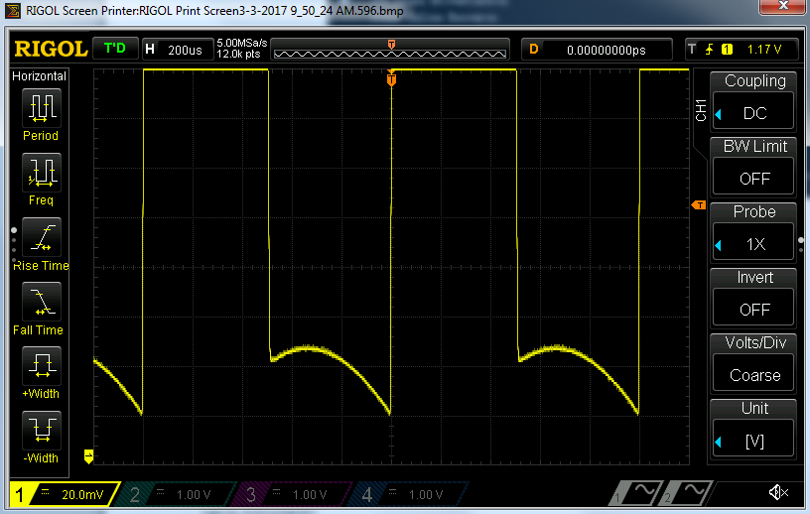
Amplifier Distortion
An Oscilloscope’s input ADC can cause distortion when the signal puts the ADC into a overdrive condition
This usually happens when significant portions of the signal are off the display
This is a normal artifact of any sampling oscilloscope
Be wary of signal artifacts when zooming with signal portions beyond the ADC’s range

Slide 12
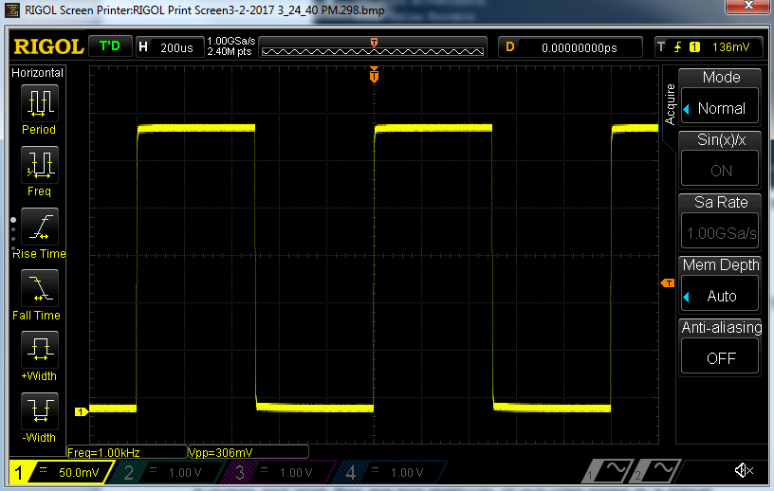
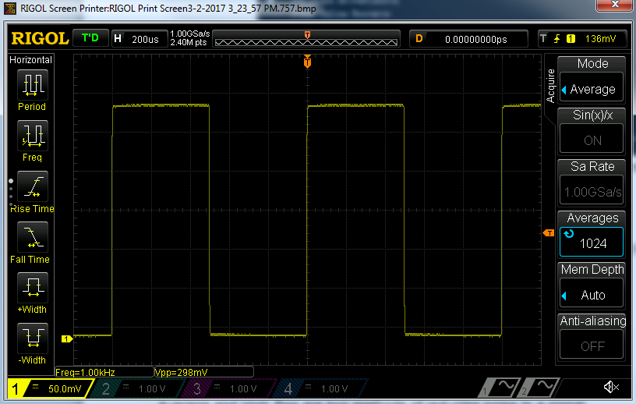
Acquisition Modes
Normal
Acquisition mode determines how the oscilloscope displays data from its memory
Normal mode displays evenly spaced data points
Peak emphasizes outlying data points
Average shows each point averaged over the last n captures
High Resolution averages within a single capture to lower noise without compromising fidelity
Be aware of your acquisition mode; Averaging will hide occasional glitches; High resolution will hide noise; Normal can miss high frequency spikes
High Resolution

Slide 13
AC vs DC Oscilloscope Channel Coupling
DC Coupling is the most common, default measurement method. Ideal for viewing the true amplitude of a signal
AC Coupling removes the DC portions of the signal making it easier to analyze waveforms that may have a large DC offset
To avoid errors make certain to use DC coupling when true amplitude or offset measurements are required

Slide 14
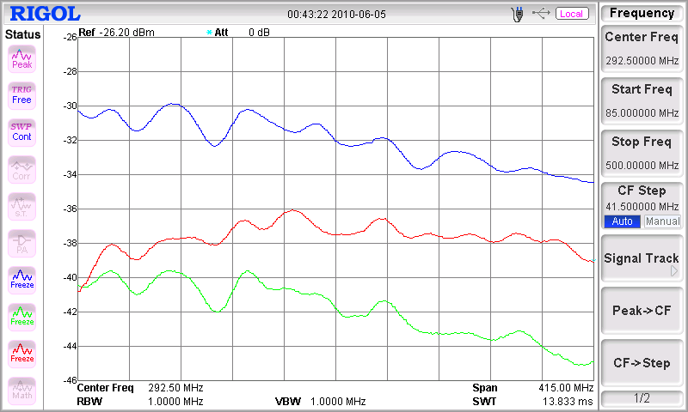
Probe Basics
Passive Probes are not flat over bandwidth. Be aware that they attenuate different frequencies differently
Passive Probes also have lower bandwidth in 1X mode. Older probe may only work to a few MHz. Newer wideband 1X probes can be good to 35 MHz or more
Use differential probes for non-ground referenced signals
For higher speed and lower noise consider active probe technology
Some probes have 1X/10X selector switches. Make certain the scope and probe settings match to get correct amplitude readings

Slide 15
Probe Loading
Probe loading is when connecting the oscilloscope’s probe to the device actually changes the signals in the device by loading down the circuit causing voltage levels to fall
This is usually caused when the input impedance of the scope is insufficient and the scope itself becomes a relevant path to ground for current within the circuit
With 99MΩ and 1MΩ in series, 50 mV should be present across the 1MΩ resistor
99 MΩ
0.05 V
5 VDC
1 MΩ
0 V

Slide 16
Probe Loading
1MΩ in parallel with 1MΩ = 500kΩ
With 99MΩ and 500kΩ in series, 99.5% of the voltage presents across the 99MΩ resistor leaving only 0.025V across the scope input
Avoid probe loading issues by understanding your source impedance. Use a DMM or high impedance probe to make these specialized measurements
99 MΩ
0.025 V
Scope &
Probe
5 VDC
1 MΩ
1 MΩ
0 V

Slide 17
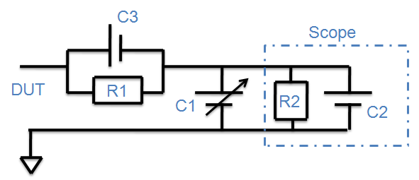
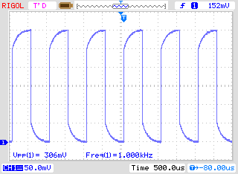
Probe Compensation
Properly compensated probes ensure the highest signal fidelity.
Use the probe compensation capacitor (C1) to balance your circuit.
R1*C3 = R2*(C1+C2)

Slide 18
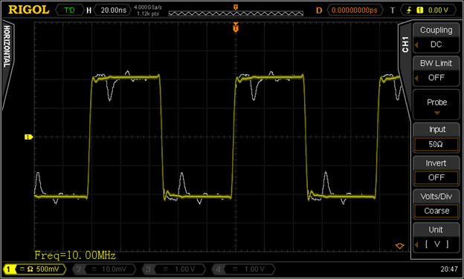
High Impedance vs. 50 Ohm Impedance
High Impedance settings maximize voltage to the scope’s input for low speed signals
Higher speed signals introduce reactance from capacitance or inductance that can cause reflections in high impedance setups
Scopes and analyzers typically use 50 Ohm impedance systems to minimize these reflections
Use 50 Ohm impedance settings to avoid signal artifacts due to reflections

Slide 19
Signal Integrity Basics Summary
Oscilloscopes and probes have many settings and characteristics that can lead users into trouble
Understanding these common issues and the theory behind them can help to avoid bad measurements which saves time and money
Be aware of the scope settings, probe specifications, and device under test characteristics when you are debugging signals or analyzing data

